Slide 1

Introduction To WCC
Source: Unit 1 : WIRELESS COMMUNICATIONS Andreas F. Molisch 1.2,1.3 and 1.4

Slide 2

Wireless everywhere…
Remote control
Cordless telephone
Headsets
Cell phones/modems
Radio!
Pagers
Satellite TV
Wireless LAN cards
Cordless headsets, mouse, keyboards, etc.
PDAs.

Slide 3
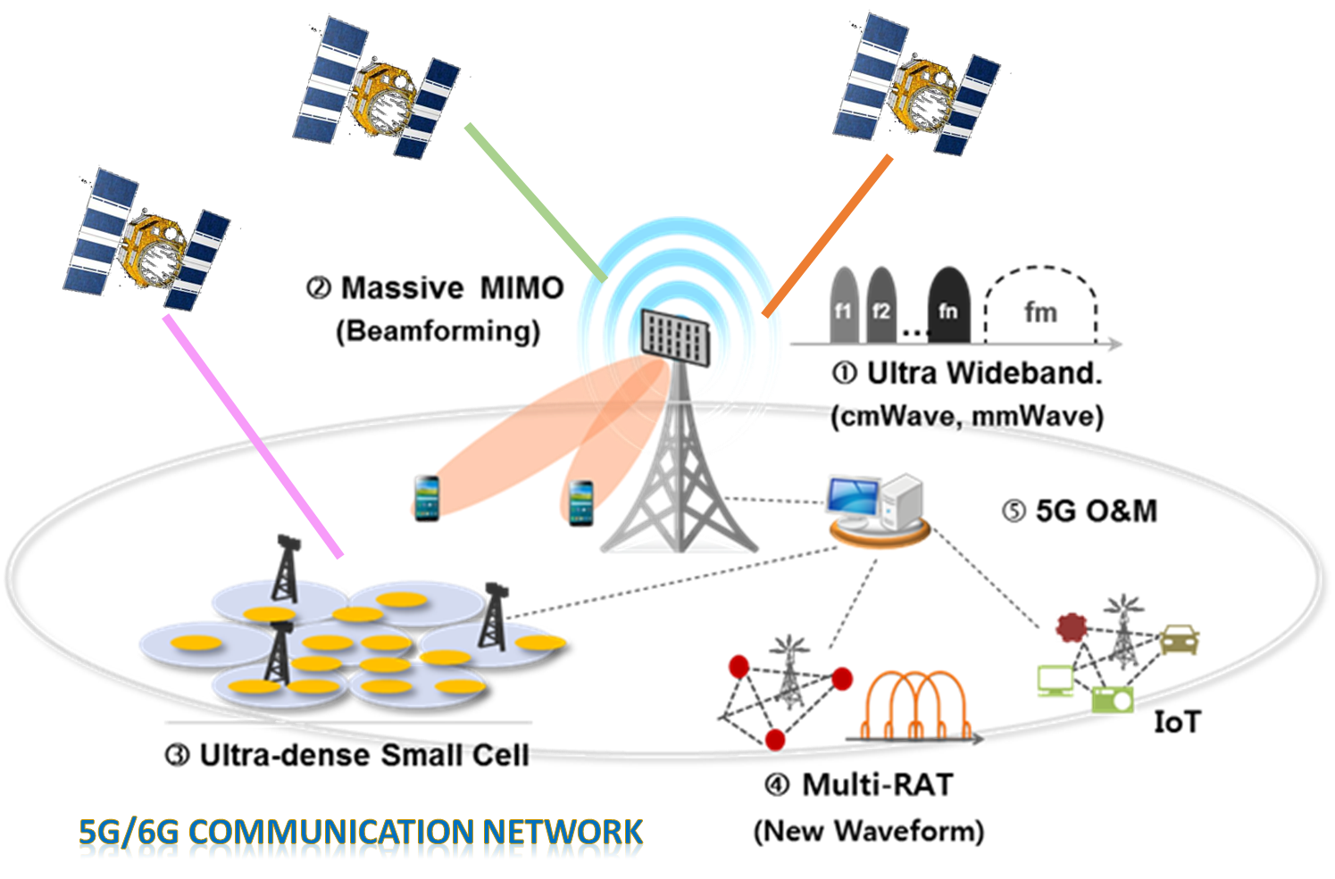
What is wireless communication?
In layman language it is communication in which information is transferred between two or more points without any wire.

Slide 4
Advantages and disadvantages of WC
Advantages:
Working professionals can work and access Internet anywhere and anytime without carrying cables or wires wherever they go. This also helps to complete the work anywhere on time and improves the productivity.
A wireless communication network is a solution in areas where cables are impossible to install (e.g. hazardous areas, long distances etc.)
Disadvantages:
Has security vulnerabilities
High costs for setting the infrastructure
Unlike wired communication, wireless communication is influenced by physical obstructions, climatic conditions, interference from other wireless devices

Slide 5
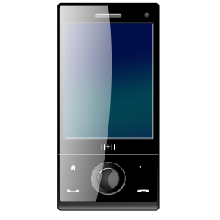
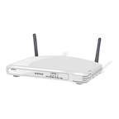
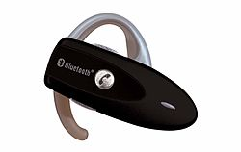
CURRENT WIRELESS SYSTEMS
CELLULAR SYSTEM
WIRELESS LANs
SATELLITE SYSTEM
PAGING SYSTEM
BLUETOOTH

Slide 6
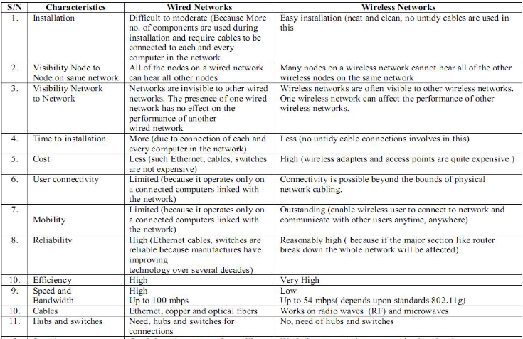
Difference between Wired and Wireless Networks

Slide 7
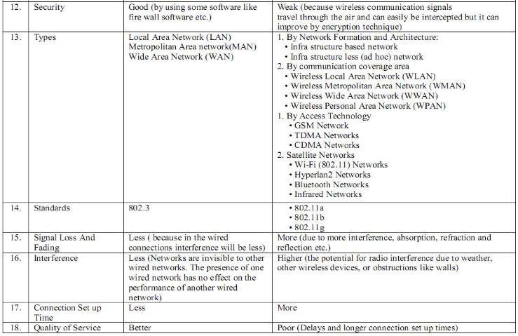
Contd..

Slide 8
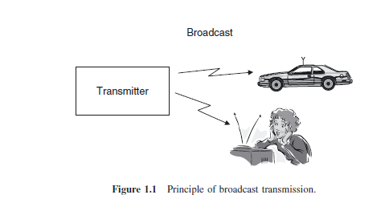
Broadcast
The information is only sent in one direction. It is only the broadcast station that sends information to the radio or TV receivers; the listeners (or viewers) do not transmit any information back to the broadcast station.
The transmitted information is the same for all users.
The information is transmitted continuously.
In many cases, multiple transmitters send the same information. This is especially true in Europe, where national broadcast networks cover a whole country and broadcast the same program in every part of that country.

Slide 9
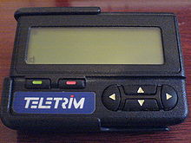
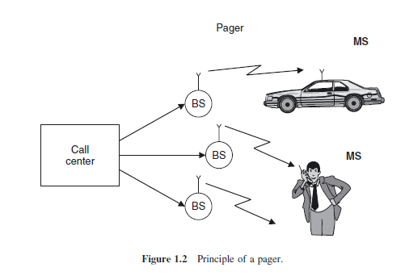
Paging
The user can only receive information, but cannot transmit. Consequently, a “call” (message) can only be initiated by the call center, not by the user.
The information is intended for, and received by, only a single user.
The amount of transmitted information is very small.

Slide 10
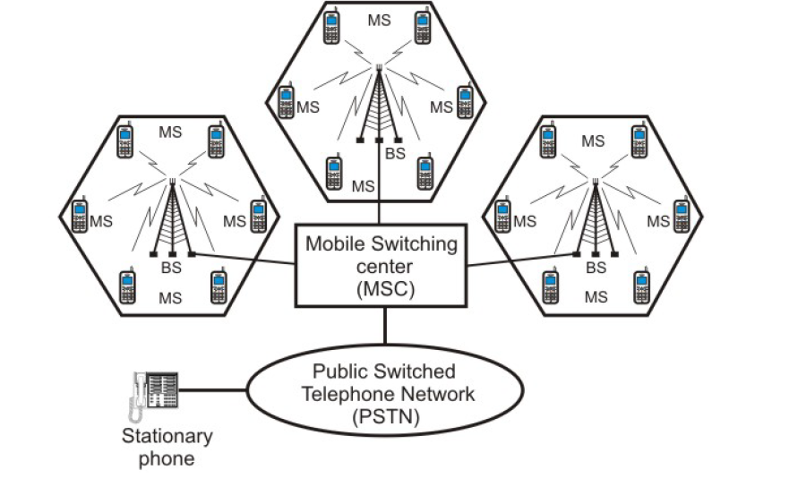
Components of cellular network

Slide 11
Contd..
A cellular system comprises the following basic components:
Mobile Stations (MS): Mobile handsets (handheld or installed in vehicles), which is used by an user to communicate with another user.
Cell: Each cellular service area is divided into small regions called cell (5 to 20 Km)
Base Stations (BS): Each cell contains an antenna (transreciever), which is controlled by a small office.
Mobile Switching Center (MSC): Each base station is controlled by a switching office, called mobile switching center . The MSC is mostly associated with communications switching functions, such as call set-up, release, and routing. It Switches voice traffic from the wireless network to the PSTN if the call is a mobile-to-landline call, or it switches to another MSC within the wireless network if the call is a mobile-to-mobile call.
Public Switched Telephone Network (PSTN): Connects several thousands of miles of transmission infrastructure, including fixed land lines, microwave, and satellite links.

Slide 12
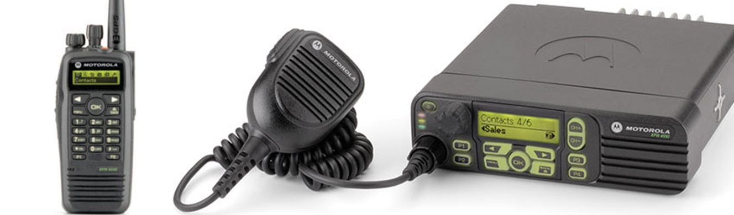
Trunking Radio
Group Calls
Call Priorities
Relay networks

Slide 13
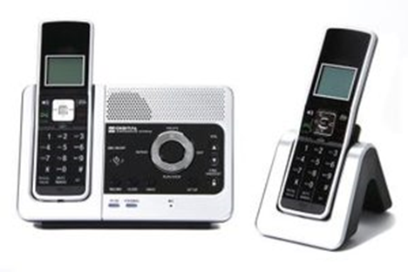
Cordless Telephony
The BS does not need to have any network functionality. When a call is coming in from the PSTN, there is no need to find out the location of the MS. Similarly, there is no need to provide for handover between different BSs.
There is no central system. A user typically has one BS for his/her apartment or business under control, but no influence on any other BSs. For that reason, there is no need for (and no possibility for) frequency planning.
The fact that the cordless phone is under the control of the user also implies a different pricing structure: there are no network operators that can charge fees for connections from the MS to the BS; rather, the only occurring fees are the fees from the BS into the PSTN.

Slide 14
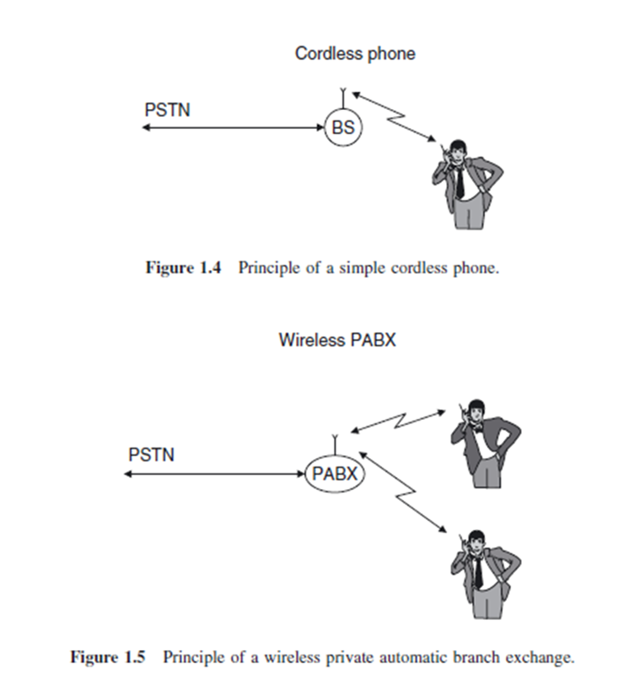
Contd..
Private automatic branch exchange

Slide 15
The Difference Between a Cordless & Cellular Phone
CORDLESS PHONES | CELL PHONES
Cordless phones consist of a base station and the cordless phone itself. A cordless phone will not work if it is outside of the range of the base station. | If the cell phone moves outside of the tower's range, the cell phone network automatically transfers the call to another tower so that the user can continue his call as long as he is within range of at least one tower.
Cordless phones do not need to be registered with the phone company. | Before using a cell phone, you need to activate the device with the cellular service provider either by installing an activated SIM card or by contacting the service providers.

Slide 16
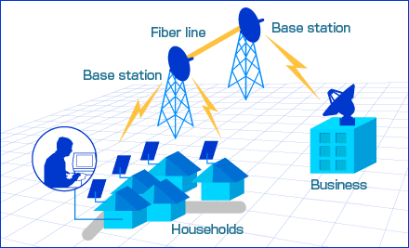
Fixed Wireless Access (FWA)
It is a type of wireless broadband data communication, which is performed between two fixed locations - connected through fixed wireless access devices and equipment..
Traditionally, enterprises used leased lines or cables to connect two different locations. FWA is cheaper alternative, specifically in densely populated areas.
Typically, FWA employs radio links as the communication and connecting medium between both locations. Usually, the fixed wireless broadcasting equipment is hoisted at building roofs on both the locations to ensure an obstruction free data transmission.

Slide 17
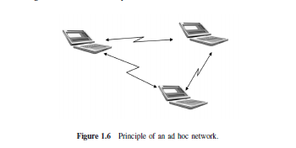
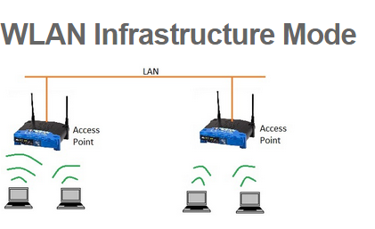
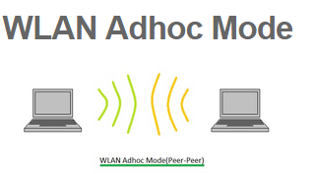
Ad-Hoc Networks
EX: Sensors

Slide 18
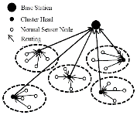
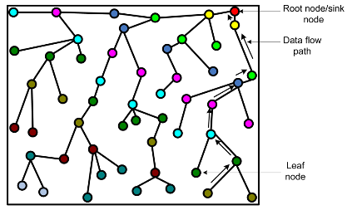
Contd..

Slide 19
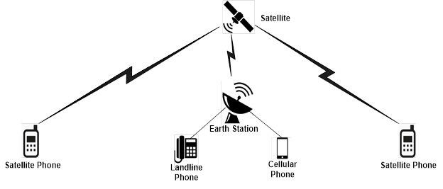
Satellite Communication

Slide 20
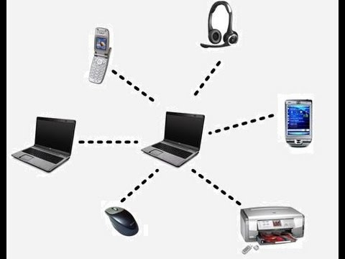
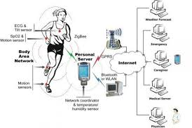
Personal Area N/W & Body area N/w

Slide 21
Requirements for the Services
Data Rate
Range and no. of users
Mobility
Energy Consumption
Direction of transmission
Service Quality

Slide 22
Data Rates
Sensors : up to 1 kbits/s ; central nodes upto 10Mbits
Speech: 5 to 64kbits/s; cordless phones : 32 kbits/s and cellphones : 10kbits/s
Elementary data services require between 10 and 100 kbit/s.
Communications between computer peripherals and similar devices: 1Mbits/s
High-speed data services: WLANs and 3G cellular systems 0.5 to 100Mbits/s
Personal Area Networks (PANs): over 100Mbits/s

Slide 23
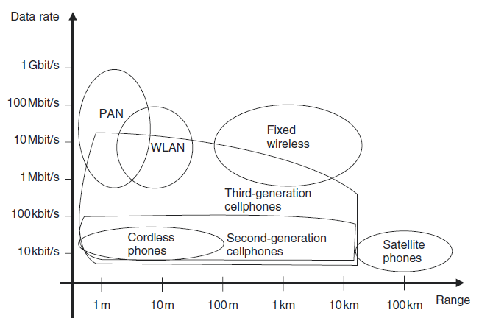
Range and Number of Users
Body Area Networks : 1m
Personal Area networks : 10m
Wireless Area Network : 100m; no.of users :10 ; cordless phones :300m
Cellular Systems: Microcells-500m, macrocells – 10 or 30 Km radius; no.of users :5 -50
Fixed wireless access services: between 100m and several tens of kilometers
Satellite Systems

Slide 24
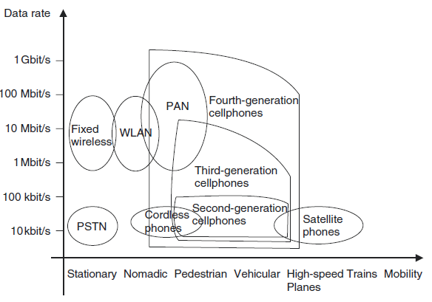
Mobility
Fixed Devices : telephones
Nomadic Devices: laptop
Low Mobility: cordless
High Mobility: cellphones
Extremely High Mobility: cellphones in a moving car

Slide 25
Energy Consumption
Rechargeable Batteries: mobiles
One Way Batteries: sensors
Power Mains: BSs and other fixed devices can be connected to the power mains (antennas)

Slide 26
Use Of Spectrum
Spectrum dedicated to service and operator : certain part of the electromagnetic spectrum is assigned, on an exclusive basis, to a service provider.
Spectrum allowing multiple operators
Spectrum dedicated to a service : the spectrum can be used only for a certain service
Free Spectrum :The ISM( industrial, scientific, and medical radio ) band at 2.45 GHz is the best known example – it is allowed to operate microwave ovens, Wi-Fi LANs, and Bluetooth wireless links, among others,
Ultra Wide Bandwidth systems
Adaptive spectral usage
USSR code: *#06# (IMEI), SAR: *#07# , Samsung: *#0011# → Stack, Iphone: *3001#12345#* to see frequency band.

Slide 27
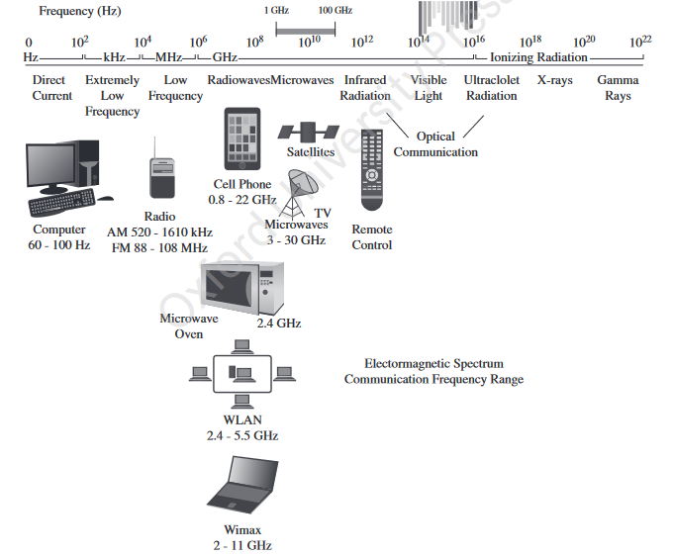

Slide 28
Direction Of Transmission
Simplex: broadcast systems :TV
Semi-Duplex: walkie talkie
Full Duplex: cell phones
Asymmetric Duplex: digital subscriber line (DSL) technologies

Slide 29
Service Quality
Speech quality: Mean Opinion Score
Data Services : file transfer service: bits/s
Delay :
Voice : 100ms
Video : Streaming allowed
Critical Services
Service Quality
Cell phones : the complement of “fraction of blocked calls plus 10 times fraction of dropped calls.”
For emergency services and military applications: the complement of “fraction of blocked calls plus fraction of dropped calls.”

Slide 30
Economic and Social Aspects
1. Economic Requirements for Building WC Systems
Use less expensive digital circuitry
Integrate all components into 1 chip rather than using 2 chips (one for analog RF circuitry and one for digital(baseband) processing).
Reduce human labour
Same chips should be used in as many systems as possible.
Reduce price difference between wired and wireless systems.
Cost of building infrastructure should be less than wired systems

Slide 31
Contd..
2. The Market for Wireless Communications
Price of the offered services
Price of MS
Attractiveness of the offered services
General economic situation
Existing telecom infrastructure
Predisposition of the population

Slide 32
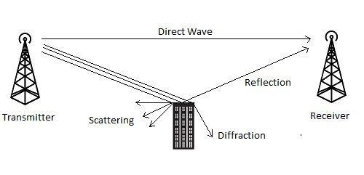
TECHNICAL CHALLENGES INVOLVED
Unit 1: Chapter 2 and 3 : WIRELESS COMMUNICATIONS
Andreas F. Molisch: 2.1,2.2,2.3 and 2.4 && 3.2
For more details on Fading refer 5.9 of Upena Dalal

Slide 33
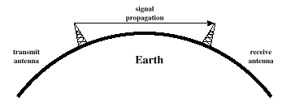
Line-of-Sight Propagation
Non Line of sight is obstructed by obstacles like buildings
Notes:
Transmitting and receiving antennas must be within line of sight
Satellite communication – signal above 30 MHz not reflected by ionosphere
Ground communication – antennas within effective line of site due to refraction

Slide 34
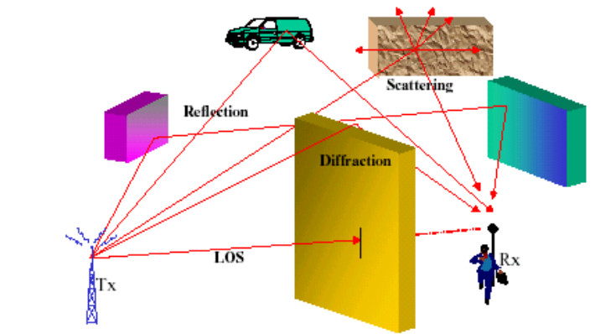
Multipath Propagation
Multipath is a propagation phenomenon that causes the transmitted signal to be sent on two or more paths to the receiver.

Slide 35
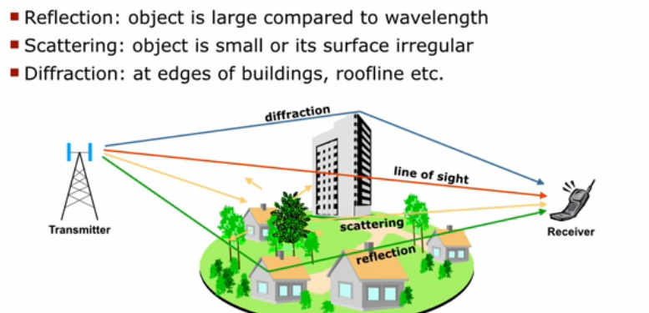
Contd..

Slide 36
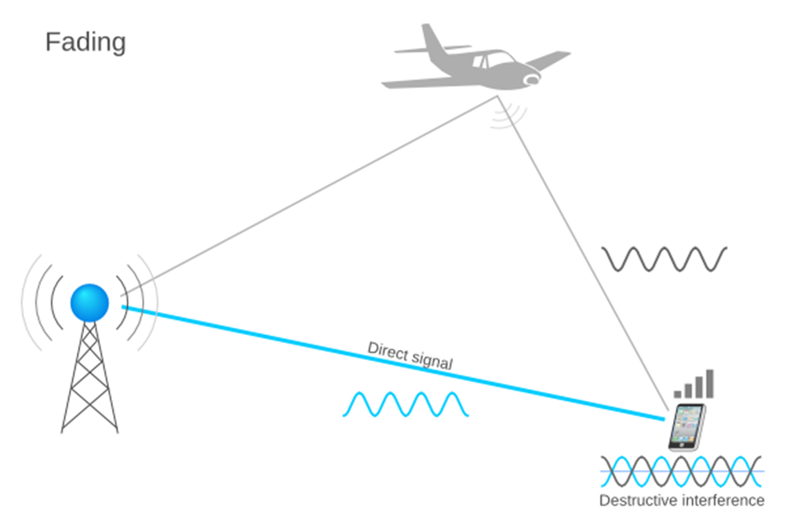
Contd..
Fading: Fading is a phenomenon cause by the constructive and destructive interference of two or more copies of the same signal that arrive at the receiver at different times.

Slide 37
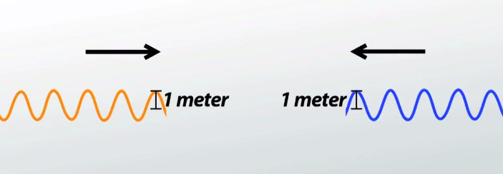
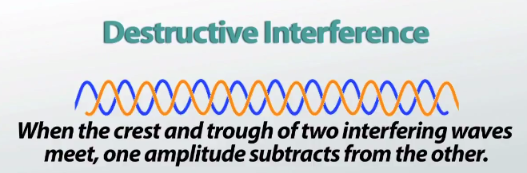
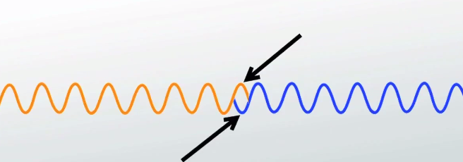
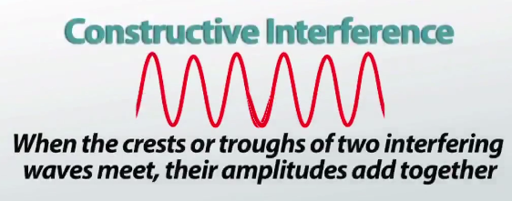
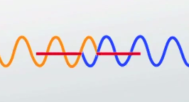
Contd..
Interference: The meeting of two or more waves travelling in the same medium

Slide 38
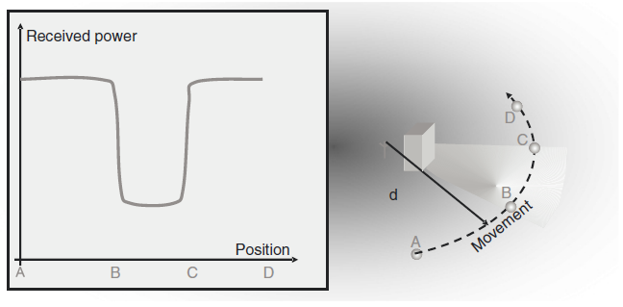
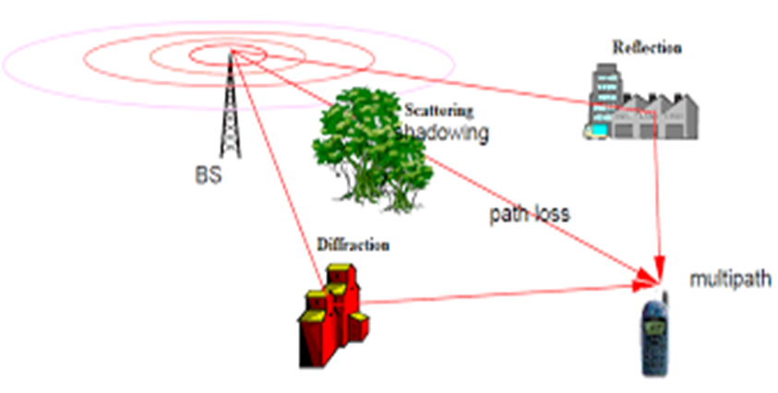
Contd..
Shadowing: Signal strength loss after passing through Obstacles

Slide 39
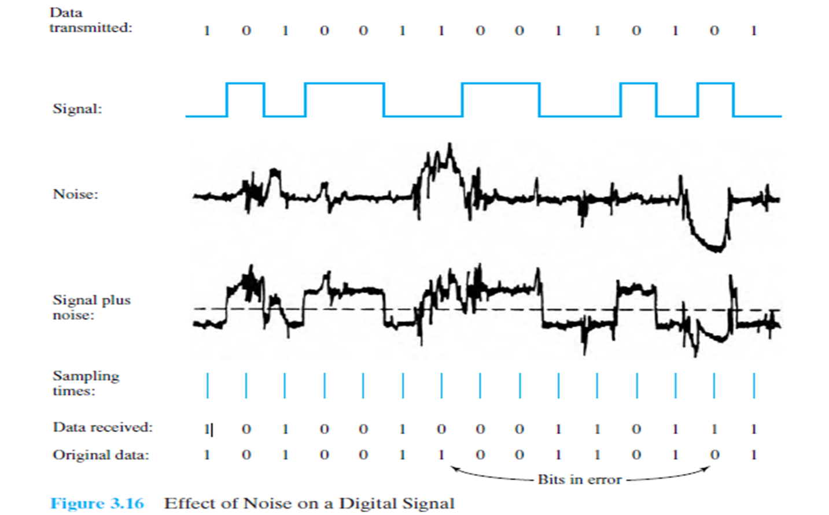
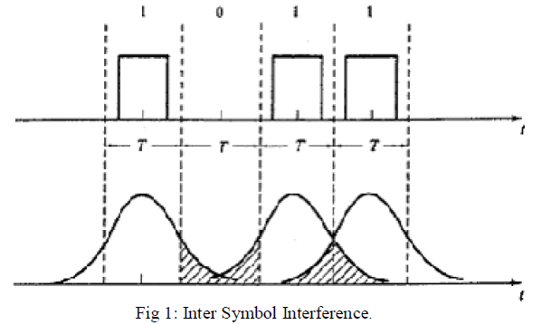
Usually the digital information that is transmitted will be in the form of square waveform representing the 1’s and 0’s. When this square waveform mixes with the noises and non linarites in the channel, the square waveform starts to spread and merge with the adjacent symbol sequence, making the data there to be unreadable. At the receiver end this data is wrongly decoded.

Slide 40
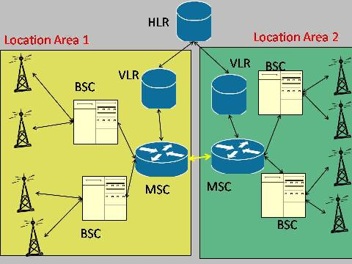
User Mobility
Spectrum Limitations
Frequency reuse in Regulated Systems
Frequency reuse in Un Regulated Systems
Home Location Register (HLR) and the Visitor Location Register (VLR).
If an MS moves across a cell boundary, a different BS becomes the serving BS; in other words,
the MS is handed over from one BS to another.
Limited Energy

Slide 41
Noise-Limited Systems
We set up link budgets for noise-limited systems and compute the minimum transmit power (or maximum range) that can be achieved in the absence of interference.
Such computations give a first insight into the basic capabilities of wireless systems and also have practical applications.
For example, Wireless Local Area Networks (WLANs) and cordless phones often operate in a noise-limited mode, if no other Base Station (BS) is in the vicinity.
Wireless systems are required to provide a certain minimum transmission quality.
The transmission quality in turn requires a minimum Signal-to-Noise Ratio (SNR) at the receiver (RX).
Consider now a situation where only a single BS transmits, and a Mobile Station (MS) receives; thus, the performance of the system is determined only by the strength of the (useful) signal and the noise.
As the MS moves further away from the BS, the received signal power decreases, and at a certain distance, the SNR does not achieve the required threshold for reliable communications.

Slide 42
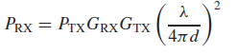
Contd..
Let us assume for the moment that the received power decreases with d², the square of the distance between BS and MS. More precisely, let the received power P_{RX} be (Eq: 3.1)
where G_{RX} and G_{TX} are the gains of the receive and transmit antennas, respectively, λ is the wavelength, and P_{TX} is the transmit power
The noise that disturbs the signal can consist of several components, as follows:
Thermal noise
Man-made noise
Spurious emissions
Other intentional emission sources
Receiver noise

Slide 43
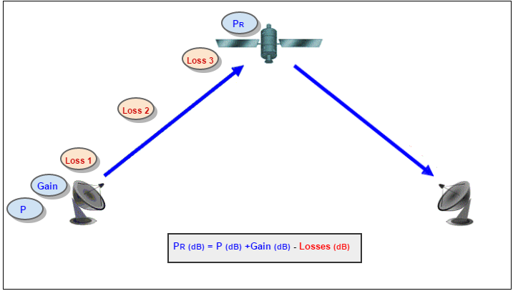
A link budget is accounting of all of the gains and losses from the transmitter, through the medium (free space, cable, waveguide, fiber, etc.) to the receiver in a telecommunication system.
Need: To be able to calculate how far we can go with the equipment we have.

Slide 44
Contd..
Thermal Noise:
The power spectral density of thermal noise depends on the environmental temperature T_{e} that the antenna “sees.” The temperature of the Earth is around 300 K (26.85 C), while the temperature of the (cold) sky is approximately T_{e} ≈ 4K (-269.15 C).
As a first approximation, it is usually assumed that the environmental temperature is isotropically 300 K. Noise power spectral density is then
where k_{B} is Boltzmann’s constant, k_{B} = 1.38 * 10⁻²³ J/K, and the noise power is
where B is RX bandwidth (in units of Hz). It is common to write Eq. (3.2) using logarithmic units (power P expressed in units of dBm is 10 log₁₀ (P/1 mW)):
This means that the noise power contained in a 1-Hz bandwidth is −174 dBm. The noise power contained in bandwidth B is
The logarithm of bandwidth B, specifically 10 log₁₀(B), has the units dBHz.

Slide 45
Contd..
Man-made noise: We can distinguish two types of man-made noise:
Spurious emissions: Many electrical appliances as well as radio transmitters (TXs) designed for other frequency bands have spurious emissions over a large bandwidth that includes the frequency range in which wireless communications systems operate.
For example urban outdoor environments, car ignitions and other impulse sources are especially significant sources of noise.
At 150 MHz, it can be 20 dB stronger than thermal noise; at 900 MHz, it is typically 10 dB stronger.
At Universal Mobile Telecommunications System (UMTS) frequencies, Neubauer et al. [2001] measured 5-dB noise enhancement by manmade noise in urban environments and about 1 dB in rural environments.
Furthermore, for communications operating in licensed bands, such spurious emissions are the only source of man-made noise.

Slide 46
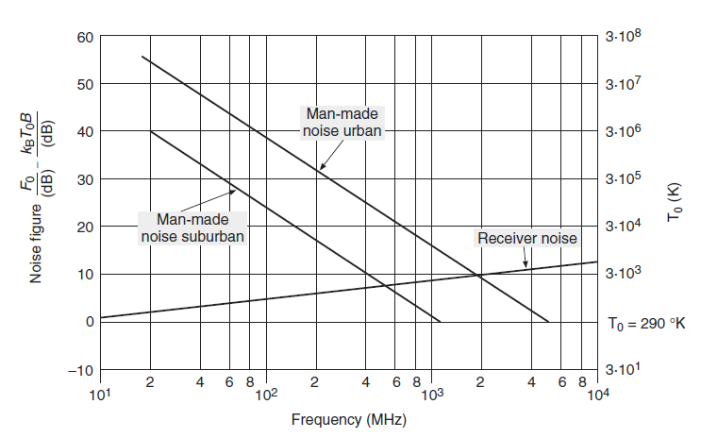
Contd..
Other intentional emission sources: Several wireless communications systems operate in unlicensed bands.
In these bands, everybody is allowed to operate (emit electromagnetic radiation) as long as certain restrictions with respect to transmit power, etc. are fulfilled.

Slide 47
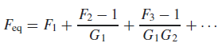
Contd..
Receiver noise: The amplifiers and mixers in the RX are noisy, and thus increase the total noise power.
This effect is described by the noise figure F, which is defined as the SNR at the RX input (typically after down conversion to baseband) divided by the SNR at the RX output.
As the amplifiers have gain, noise added in the later stages does not have as much of an impact as noise added in the first stage of the RX.
Mathematically, the total noise figure F_{eq} of a cascade of components is
where F_{i} and G_{i} are noise figures and noise gains of the individual stages in absolute units (not in decibels (dB)).
Note that for this equation, passive components, like attenuators with gain m < 1, can be interpreted as either having a noise figure of F = 1/m and unit gain of G = 1, or unit noise figure F = 1, and gain G = m.

Slide 48
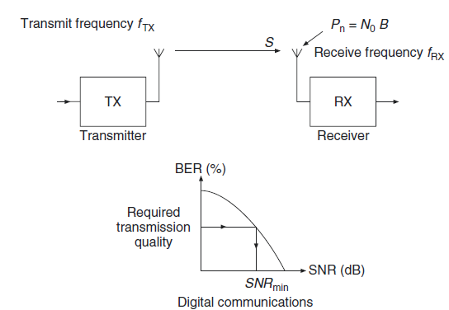
Contd..
For a digital system, the transmission quality is often described in terms of the Bit Error Rate (BER) probability.
Depending on the modulation scheme, coding, and a range of other factors, there is a relationship between SNR and BER for each digital communications systems.
A minimum transmission quality can thus be linked to the minimum SNR, SNR_{min}, by this mapping

Slide 49
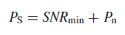
Thus, the planning methods of all analog and digital links in noise-limited environments are the same; the goal is to determine the minimum signal power PS:

Slide 50
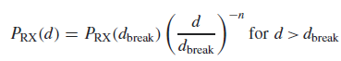
Contd..
Link Budget
A link budget is the clearest and most intuitive way of computing the required TX power.
It tabulates all equations that connect the TX power to the received SNR.
The link budget gives only an approximation (often a worst case estimate) for the total SNR, because some interactions between different effects are not taken into account.
The attenuation (path loss) due to propagation effects, between TX and RX.
For distances d < dbreak, the received power is proportional to d⁻², according to Eq. (3.1).
Wireless systems, especially mobile systems, suffer from temporal and spatial variations of the transmission channel (fading).
In other words, even if the distance is approximately constant, the received power can change significantly with small movements of the TX and/or RX.

Slide 51
Contd..
Uplink (MS to BS) and downlink (BS to MS) are reciprocal, in the sense that the voltage and currents at the antenna ports are reciprocal (as long as uplink and downlink use the same carrier frequency).
However, the noise figures of BSs and MSs are typically quite different.
As MSs have to be produced in quantity, it is desirable to use low-cost components, which typically have higher noise figures.
Furthermore, battery lifetime considerations dictate that BSs can emit more power than MSs.
Finally, BSs and MSs differ with respect to antenna diversity, how close they are to interferers, etc. Thus, the link budgets of uplinks and downlinks are different.

Slide 52
Contd..
The performance of any communication link depends on the quality of the equipment being used.
Link budget is a way of quantifying the link performance.
The received power in an 802.11 link is determined by three factors: transmit power, transmitting antenna gain, and receiving antenna gain.
If that power, minus the free space loss of the link path, is greater than the minimum received signal level of the receiving radio, then a link is possible.
The difference between the minimum received signal level and the actual received power is called the link margin.
The link margin must be positive, and should be maximized (should be at least 10dB or more for reliable links).

Slide 53
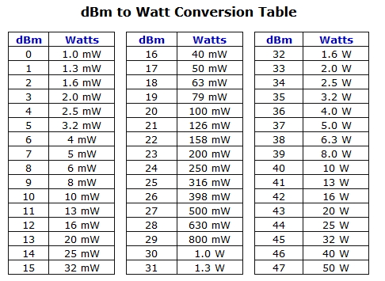
Contd..

Slide 54
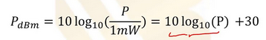
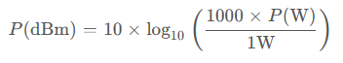


Contd..
How to calculate power (in dBm) for the given watts?
How to calculate power (in dBm) for the given milliwatts?
dBm stands for decibel-milliwatts; is a dimensionless unit used to define/measure signal strength (power level), with reference to 1 milliwatt. (i.e., the power level of 0dBm represents 1 milliwatt).
The dBm is a convenient unit; used in radio, microwave, audio applications, and fiber-optical communications networks to measure signal strength.
A signal’s power level lower than 1 mW has negative dBm values, and the signals stronger than 1 mW have positive dBm values.
Web link: https://www.rapidtables.com/electric/dBm.html

Slide 55


Contd..
How to calculate watts for the given power (in dBm)?
How to calculate milliwatts for the given power (in dBm)?
Suppose your mobile receives an RSSI value (Receiver Signal Strength Indicator) is -92 dBm. Find the signal power at the receiver in milli-watts.
P_{mW} = 10^{-92/10} = 10^{-9.2} = 6.3095 x 10⁻¹⁰ milli-watts
Pw = 10^{(-92-30)/10} = 10^{-12.2} = 0.6309 x 10⁻¹² watts
Mobile tower uses around 200 watts of power to transmit the signal. Find the power in dBm.
P_{dBm} = 10 log ₁₀ (200) + 30 = 23.010 + 30 = 53.010 dBm

Slide 56

Contd..

Slide 57
Example link budget calculation
Let’s estimate the feasibility of a 5 km link, with one access point and one client radio.
The access point is connected to an antenna with 10 dBi gain, with a transmitting power of 20 dBm and a receive sensitivity of -89 dBm.
The client is connected to an antenna with 14 dBi gain, with a transmitting power of 15 dBm and a receive sensitivity of -82 dBm.
The cables in both systems are short, with a loss of 2dB at each side at the 2.4 GHz frequency of operation.

Slide 58


Link budget: AP to Client link

Slide 59

Opposite direction: Client to AP

Slide 60

Contd..

Slide 61

Example 1
Consider the downlink of a GSM system (see also Chapter 24). The carrier frequency is 950MHz and the RX sensitivity is (according to GSM specifications) −102 dBm. The output power of the TX amplifier is 30 W. The antenna gain of the TX antenna is 10 dB and the aggregate attenuation of connectors, combiners, etc. is 5 dB. The fading margin is 12 dB and the breakpoint dbreak is at a distance of 100 m. What distance can be covered?
Fading margin =
P_{Rx} -Rx sensitivity

Slide 62

Contd..

Slide 63


Contd..
For distances d < dbreak, the received power is proportional to d⁻², according to Eq. (3.1). Beyond that point, the power is proportional to d^{−n}, where n typically lies between 3.5 and 4.5. The received power is thus

Slide 64


Slide 65

Contd..
Consider a mobile radio system at 900-MHz carrier frequency, and with 25-kHz bandwidth, that is affected only by thermal noise (temperature of the environment Te = 300K). Antenna gains at the TX and RX sides are 8 dB and −2dB, respectively. Losses in cables, combiners, etc. at the TX are 2 dB. The noise figure of the RX is 7 dB and the 3-dB bandwidth of the signal is 25 kHz. The required operating SNR is 18 dB and the desired range of coverage is 2 km. The breakpoint is at 10-m distance; beyond that point, the path loss exponent is 3.8, and the fading margin is 10 dB. What is the minimum TX power?
Thermal noise power = = -174 + 44 = -130

Slide 66



Contd..

Slide 67


